Slide 1
CS 147 Assignment #1 Needfinding
Accessible Design Studio
Emily Huang
Po-Ting Lin
Jared Poblete
Frankie Sperka

Slide 2
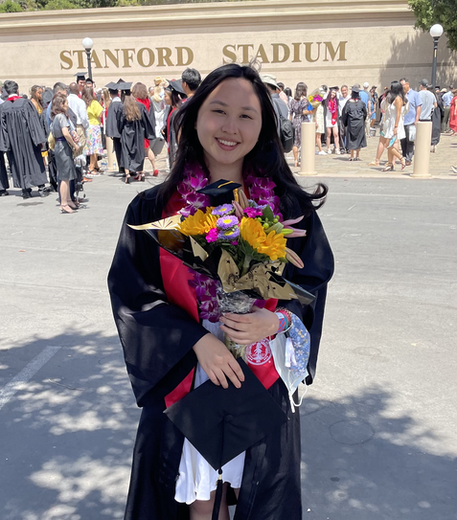
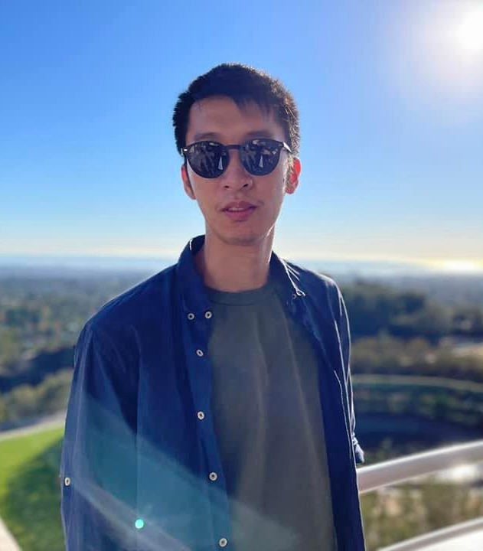
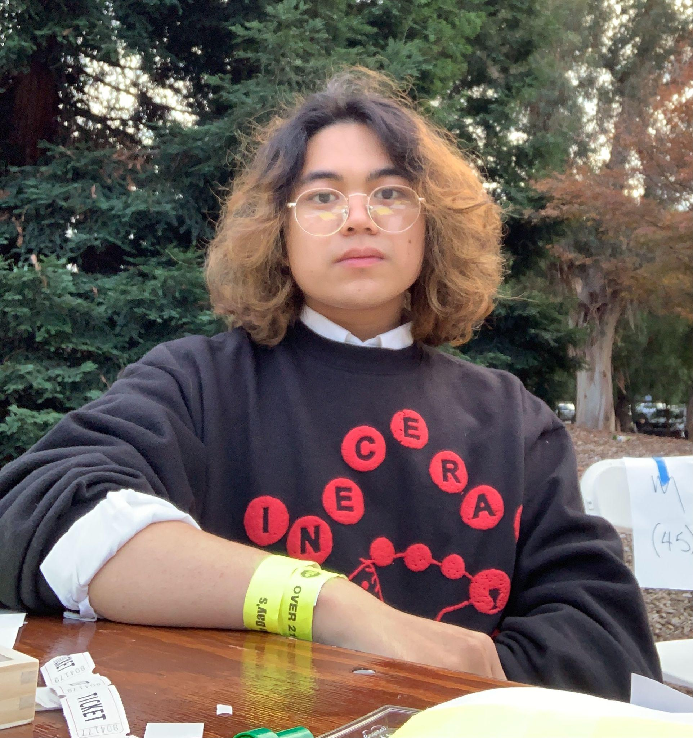
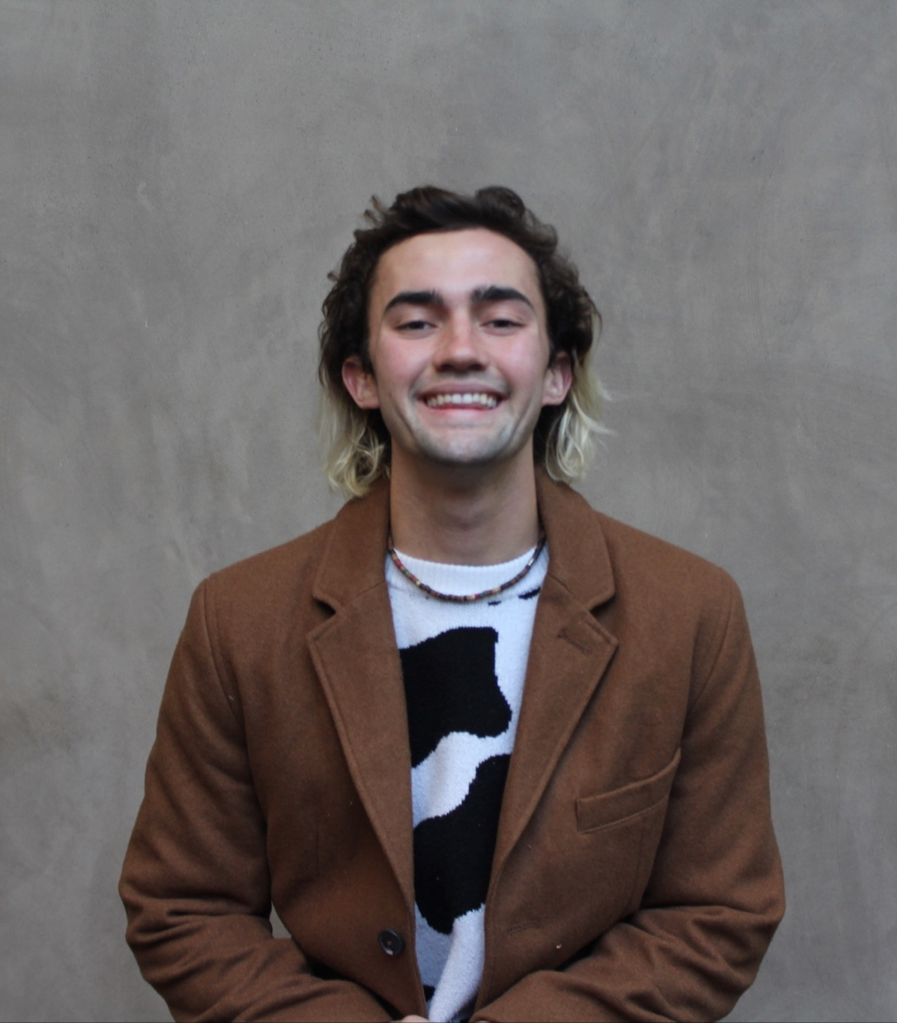
Team Members
Emily Huang
Po-Ting Lin
Jared Poblete
Frankie Sperka
Senior/Coterm in
Computer Science
Master’s in
Materials Science
Junior in
Symbolic Systems
Sophomore in Product Design

Slide 3
Domain
The Deaf Community
Accessible Design for Different Abilities

Slide 4
Needfinding Methodology Introduction
Hard of Hearing Individuals
Adjacent members of Deaf community
Deaf Individuals
Notes:
Specify accommodations

Slide 5
Needfinding Methodology We Asked About
General
What is your relation to the Deaf community?
Tell me about a time where you did not feel as included in a space?
Entertainment
What types of media do you particularly enjoy?
Tell me about a time when you experienced art or entertainment?
Mobile Apps / Technology:
What apps do you use on a day-to-day basis?
Tell me about your experience using mobile apps? Is there anything you like / dislike?
Pandemic
How has the ongoing pandemic affected the Deaf community?
Have you found anything that has helped with this change?

Slide 6
Johnny
a college graduate
born deaf who now uses two cochlear implants
Zoom interview, 4o minutes
“Covid has just amplified problems that already existed.”

Slide 7
Michelle
audiologist & mother of 3
born hard of hearing, now uses two cochlear implants
Zoom interview, 3o minutes
“Hearing is something that is difficult for me, visual is something that is easy.”

Slide 8
Catherine
university ASL professor
born into a 3 generation deaf household
Zoom interview, 6o minutes
“The deaf community is very very close.”

Slide 9
Catherine
high schooler & daughter
child of deaf adults (CODA)
Zoom interview, 50 minutes
“Now I feel proud about my identity as a CODA.”

Slide 10
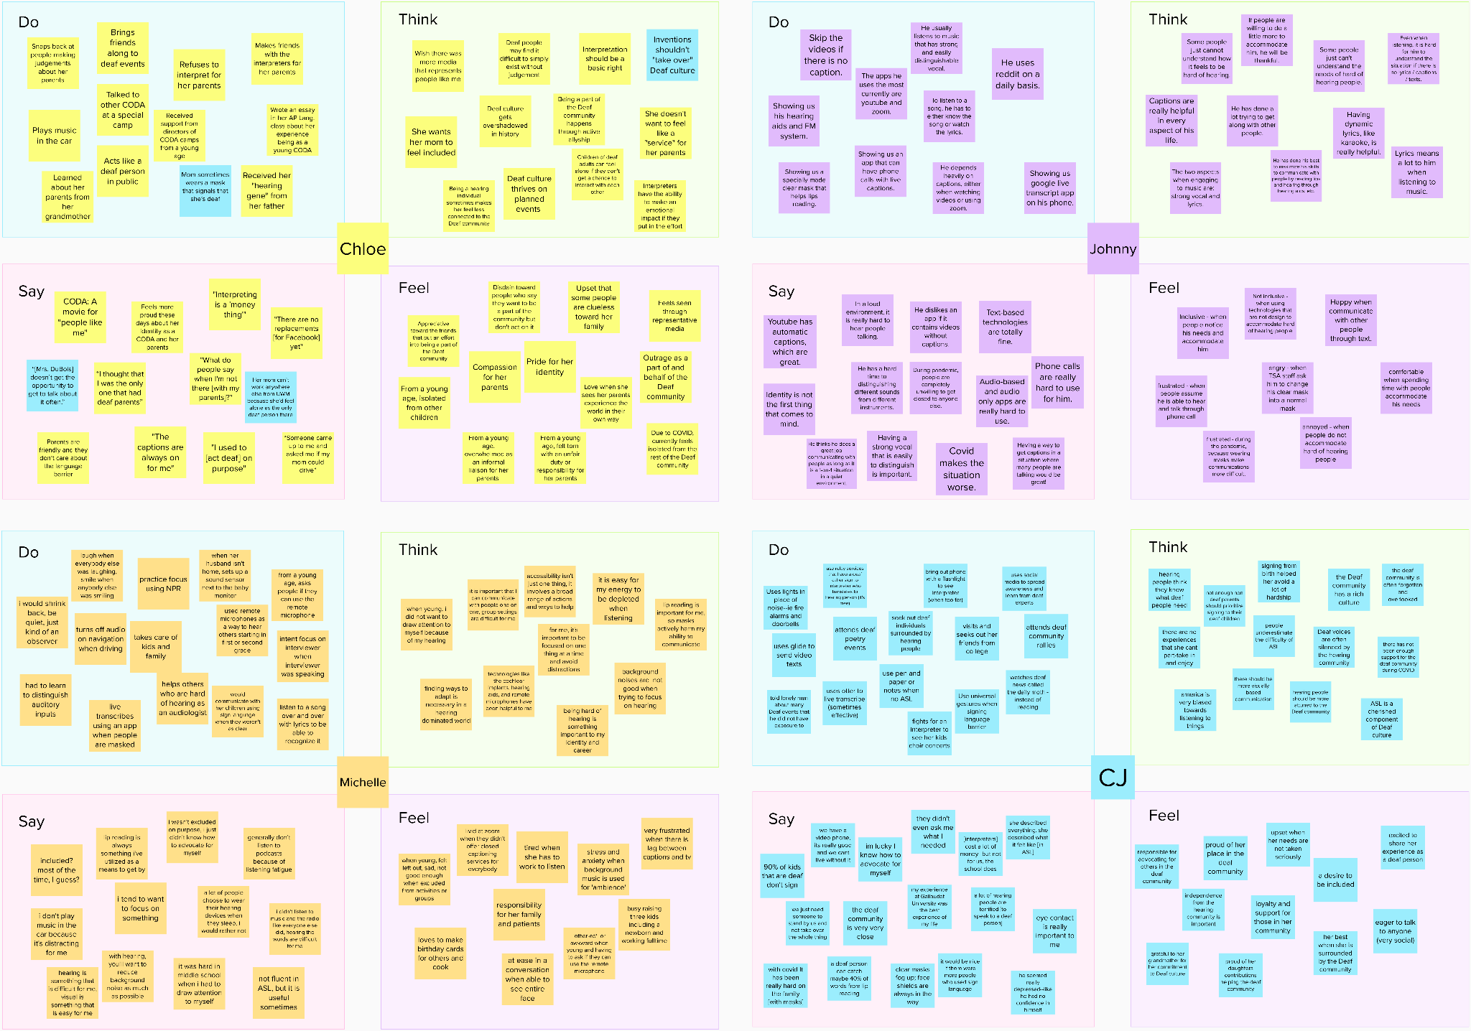
Analysis
Empathy Maps
Notes:
https://app.mural.co/t/dschoolteachinglearning2156/m/dschoolteachinglearning2156/1642136434617/e38fc5478a674f18773e95a12336123d5b348c6c?sender=u267c7315fd4bb9f23b057027

Slide 11
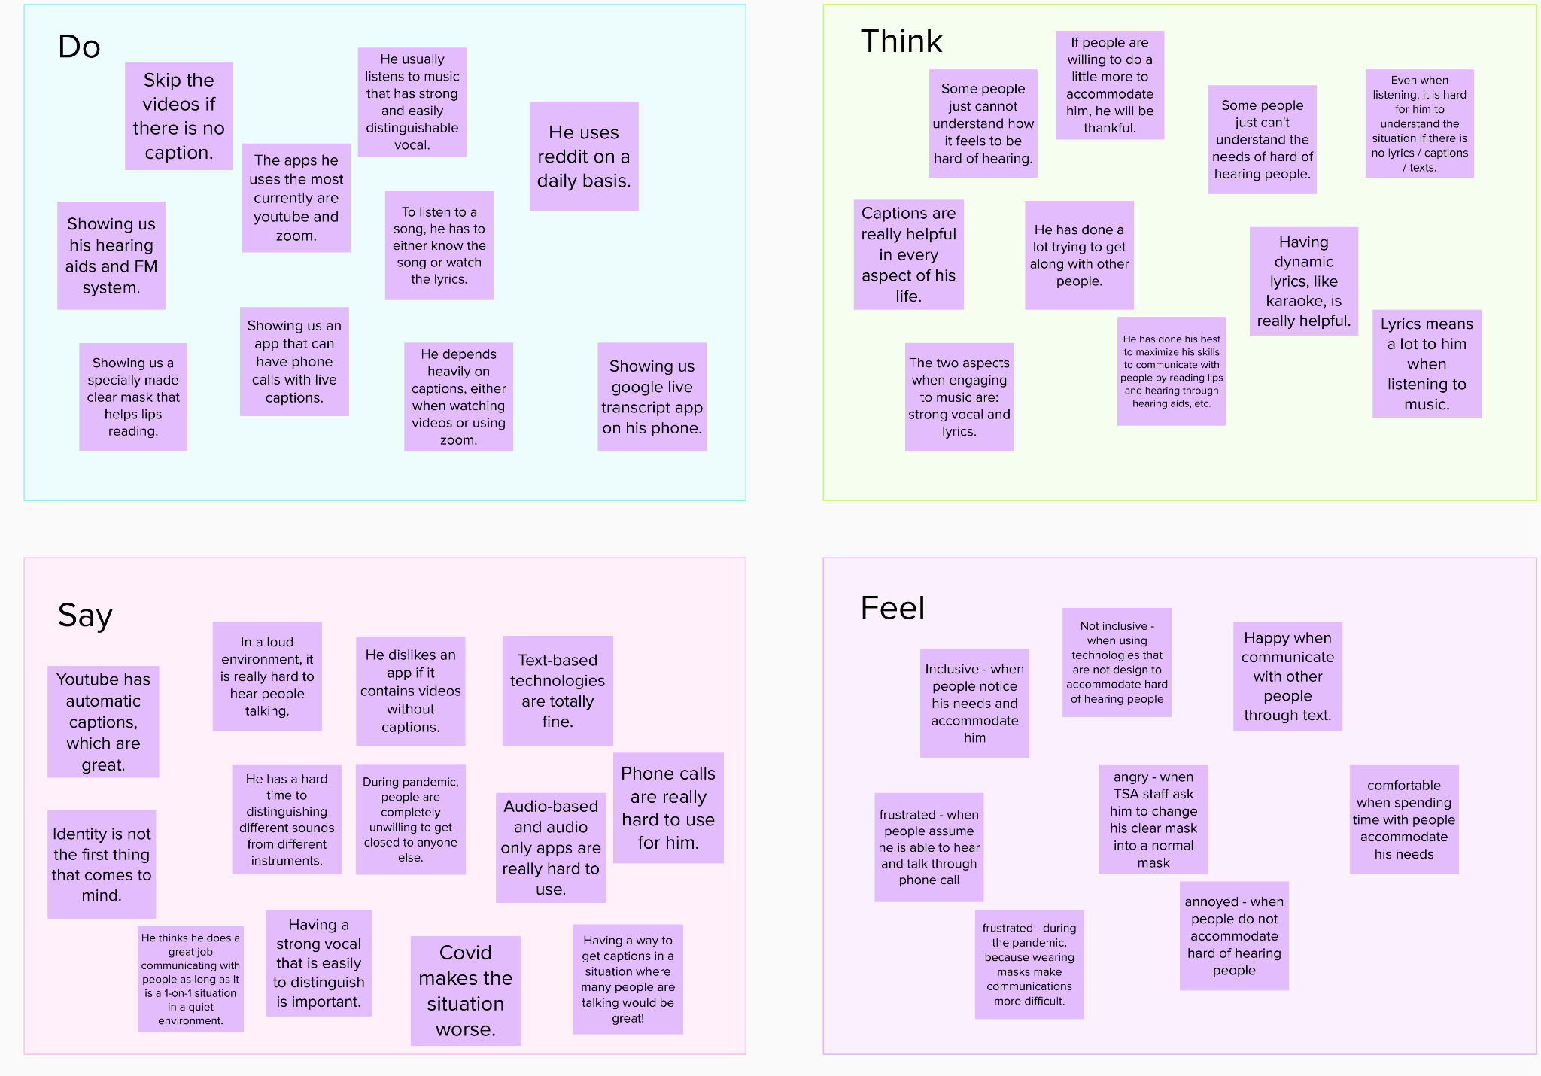
Analysis
Empathy Map:
Johnny

Slide 12
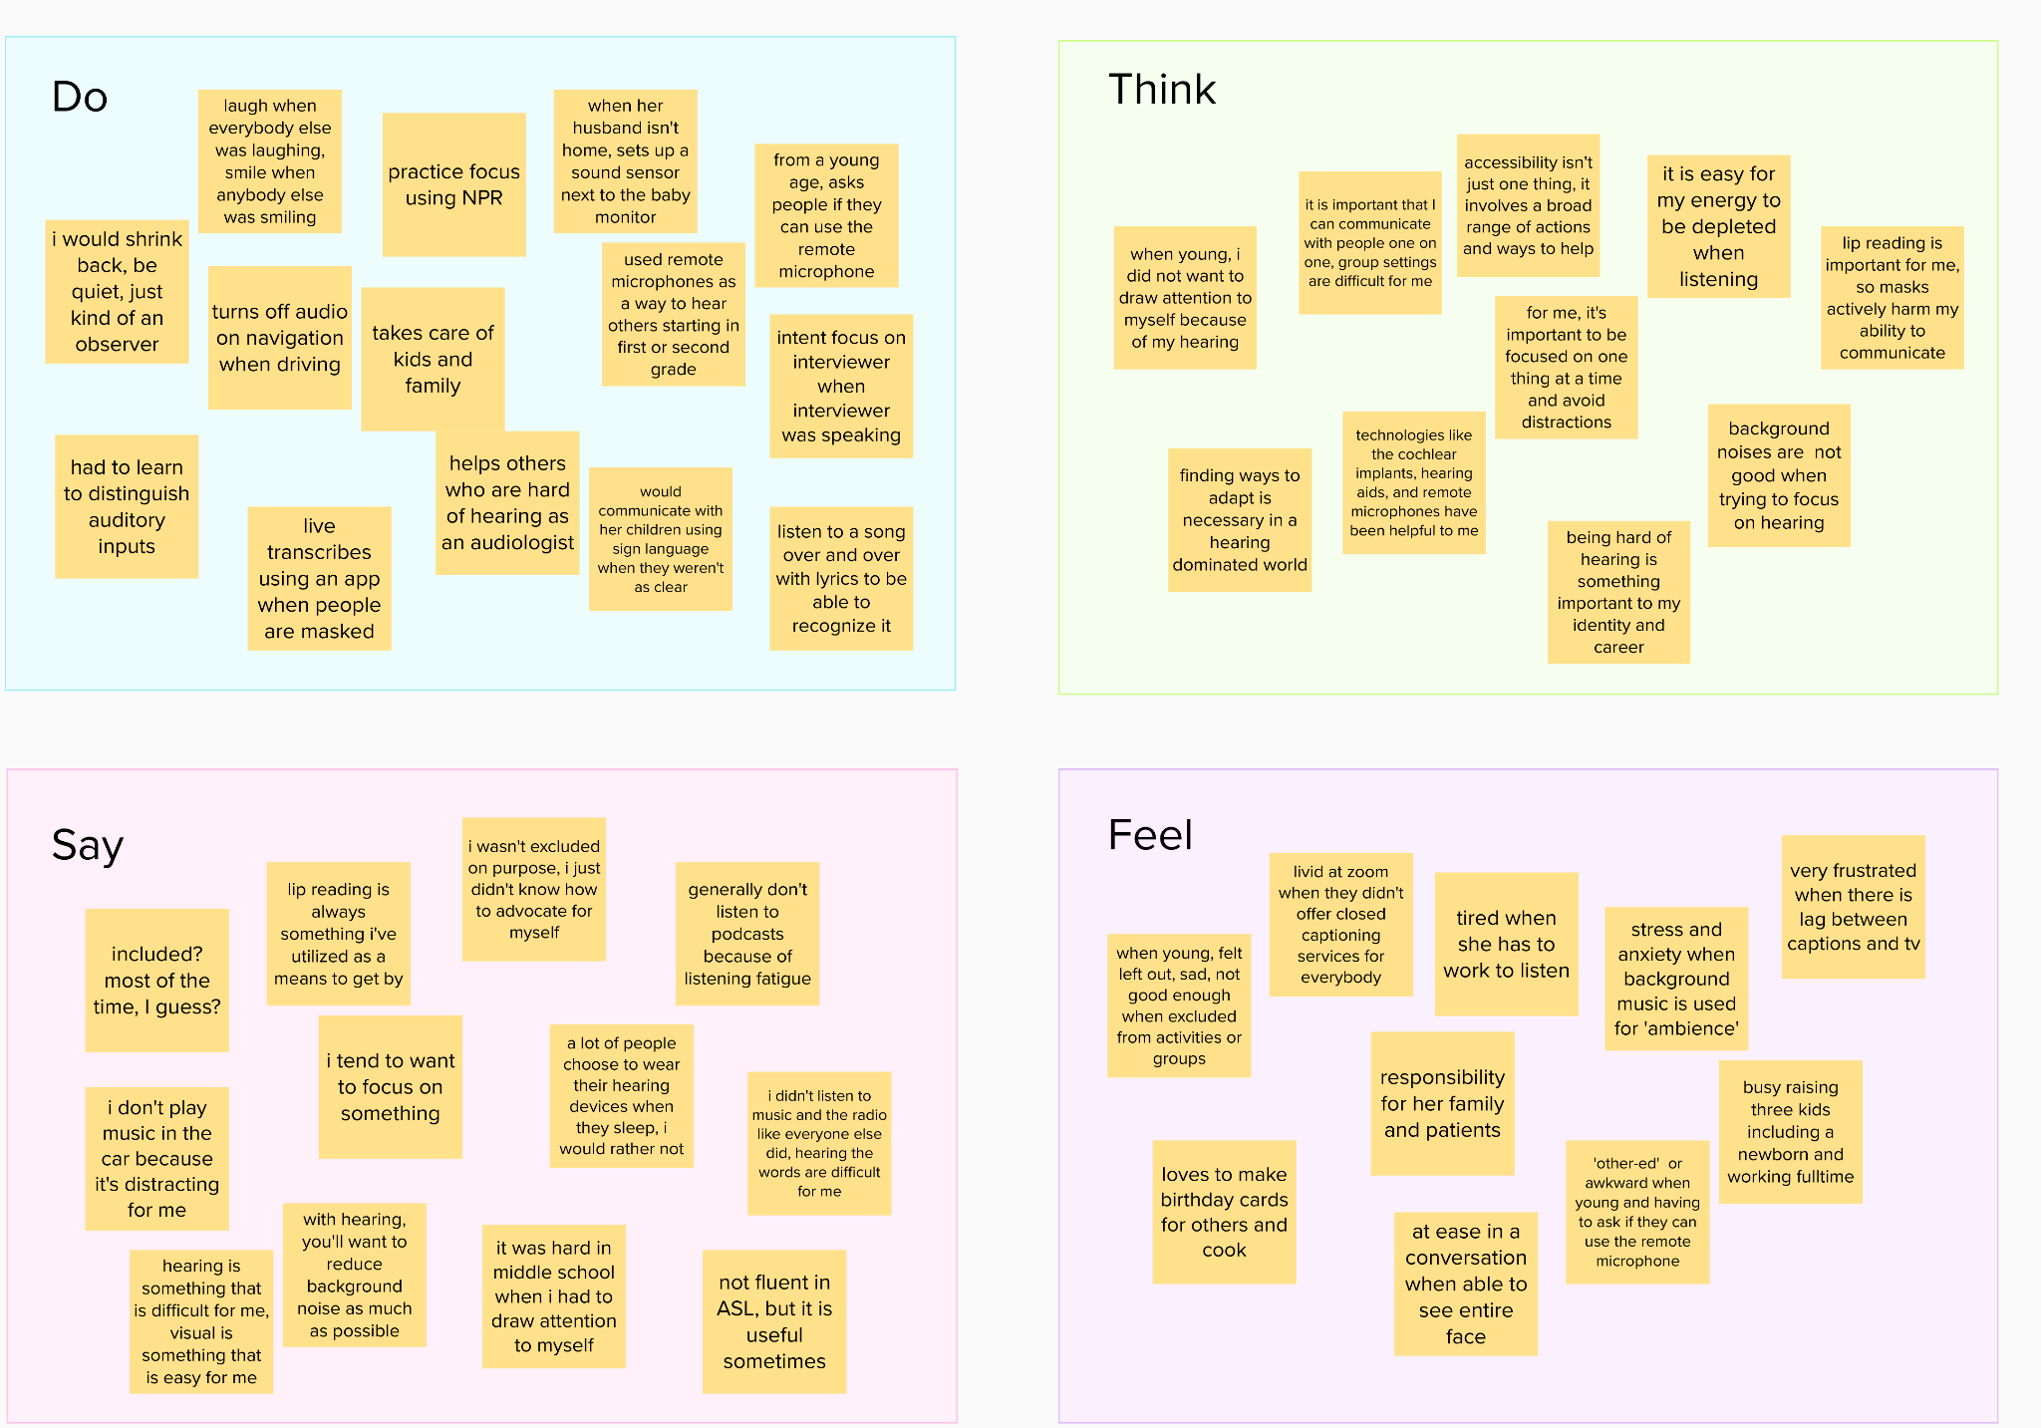
Analysis
Empathy Map:
Michelle

Slide 13
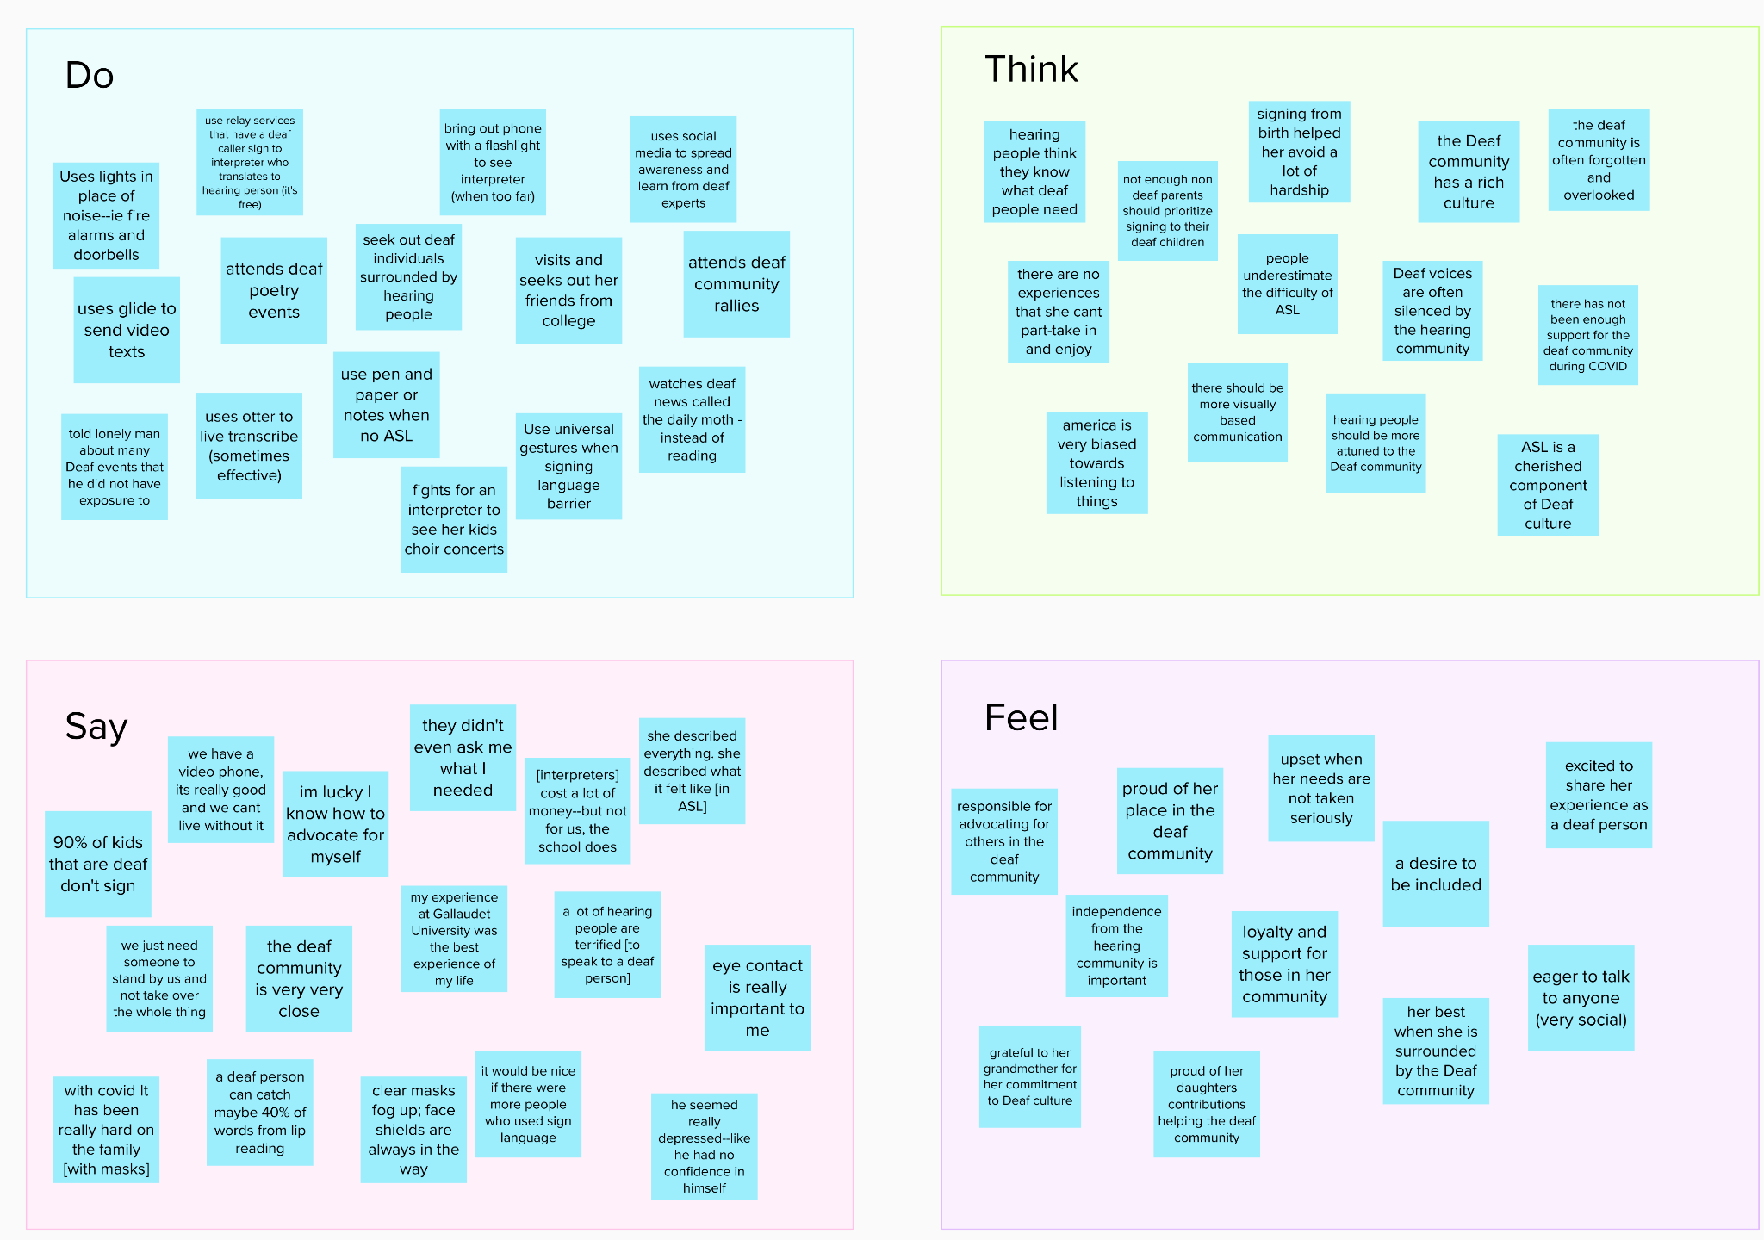
Analysis
Empathy Map:
CJ

Slide 14
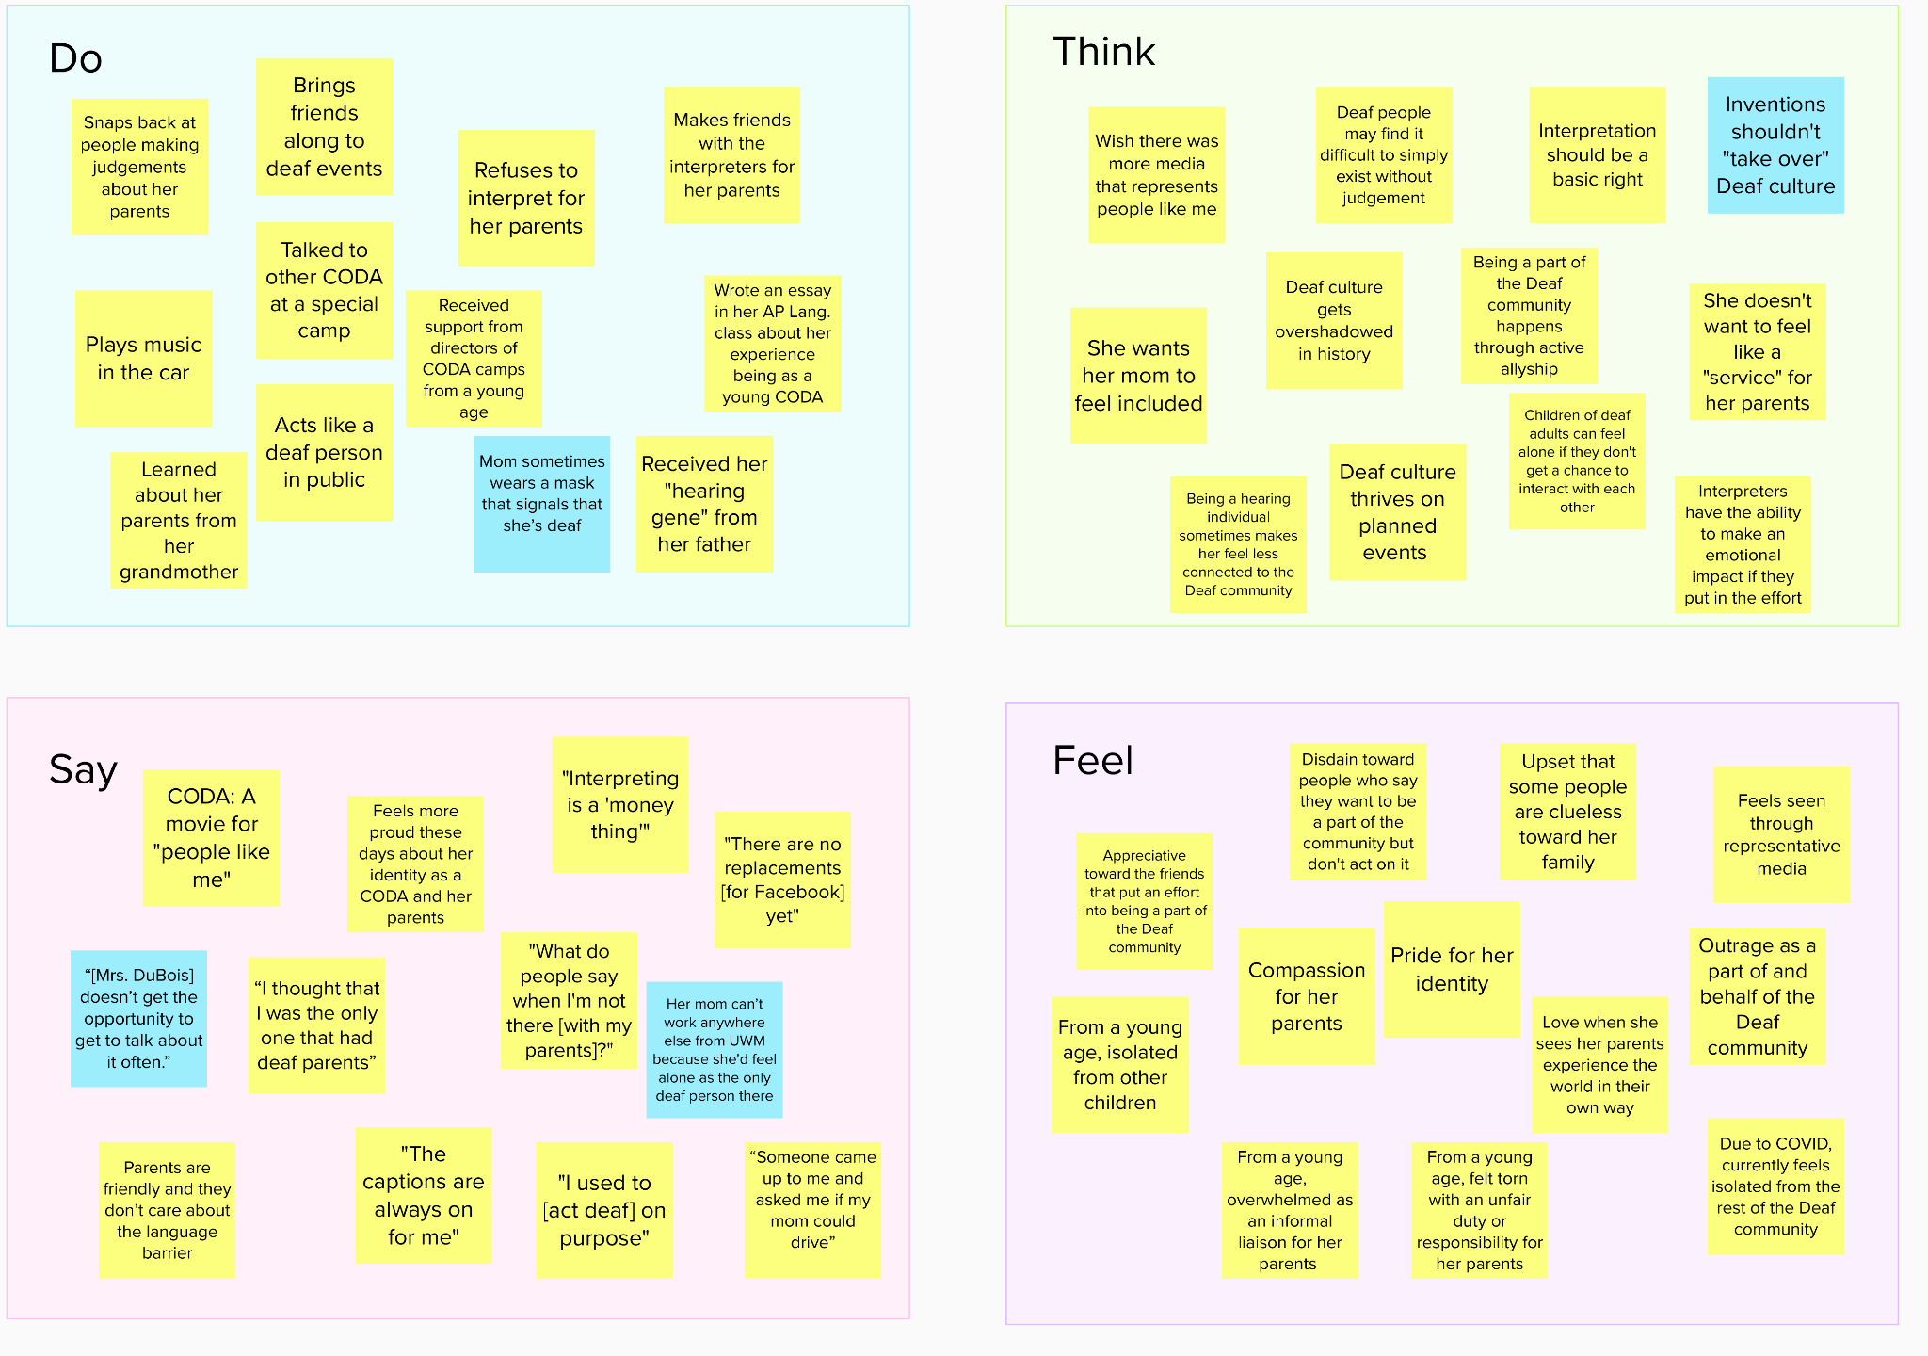
Analysis
Empathy Map:
Chloe

Slide 15
Tensions, Contradictions, Surprises
Tensions
Contradictions
Surprises
Use universal gestures when signing language barrier
She wants her mom to feel included →
Refuses to interpret for her parents
90% of kids that are deaf don't sign
[interpreters] cost a lot of money--but not for us, the school does
America is very biased towards listening to things
During pandemic, people are completely unwilling to get close to anyone else.
people have run away from her in fear
“Someone came up to me and asked me if my mom could drive”

Slide 16
Tensions, Contradictions, Surprises (contin.)
Tensions
Contradictions
Surprises
stress and anxiety when background music is used for 'ambience'
"I used to [act deaf] on purpose"
our art has no noise or music → attends kids choir concerts
Skip the videos if there is no caption.
very frustrated when there is lag between captions and tv
"Interpreting is a 'money thing'"

Slide 17
Analysis
“In second grade, we had show and tell, but… they didn’t provide an interpreter for my mom, so she had to use Guesstures.”
Insight
Hiring interpreters can be difficult for a number of reasons including financial constraints and ignorance.
Need
A guaranteed professional interpreter should be a right.

Slide 18
Analysis
“The last [Deaf event] I went to was in 2019, right before COVID.”
Insight
Deaf events are an integral part of fostering community, but COVID has hindered that.
Need
A distanced way to support community

Slide 19
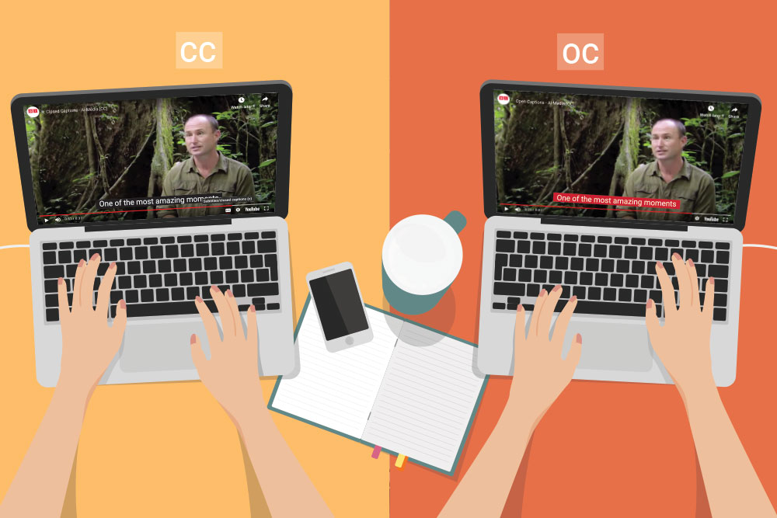
Analysis
“If there’s a video without captions, I’ll just skip it. Sometimes I’ll try to go to the comments and piece things together but it’s usually not worth it.
Insight
A lot of content and speech remains uncaptioned and inaccessible.
Need
Captioning should be more ubiquitous.

Slide 20
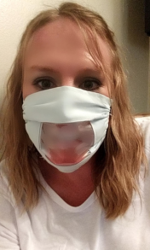
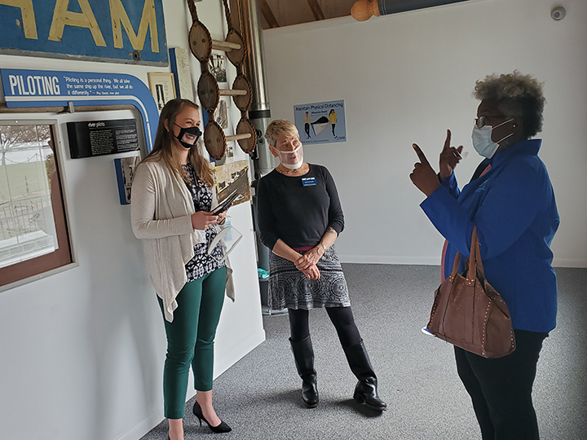
Analysis
Insight
Masks cover up part of the face, which hinders deaf individuals in ways such as stifling the emoting that is integral to conveying ASL or lipreading.
Need
There needs to be a way to support effective communication while maintaining health & safety.

Slide 21
Analysis
Conclusions
Inferences & Questions
The Deaf community is strong and heavily interconnected
How do they maintain this connectedness?
Are there ways to support this?
Independence, inclusion, and representation seem to be throughlines

Slide 22
Summary
We talked to lots of people with different experiences with deafness
We learned a lot about their culture, challenges, and connectedness
We are excited to investigate how to best support them

